Slide 1
Predictive Analysis of Traffic Accident Causes: Insights and Recommendations
A Data-Driven Approach to Improving Road Safety
Gladwell Chepkorir

Slide 2
Introduction
Problem Statement: The City of Chicago has experienced a high incidence of traffic accidents, leading to significant concerns about road safety and the well-being of its residents. To address this issue, it is crucial to identify the primary contributory causes of these accidents. By understanding the factors that most frequently contribute to crashes, we can implement targeted interventions and policies aimed at reducing the number of traffic incidents. This project focuses on analyzing traffic crash data to uncover key patterns and contributory causes, with the ultimate goal of enhancing road safety and minimizing accidents in the city.
Objective: Predicting the primary contributory cause of traffic accidents and providing actionable insights.

Slide 3
Dataset Overview
Dataset: Chicago Traffic Crashes Dataset
Key Features - Speed_Weather_Interaction, Is_Weekend, CRASH_HOUR_sin and CRASH_HOUR_cos, LANE_CNT, ROADWAY_SURFACE_COND, TRAFFIC_CONTROL_DEVICE, DEVICE_CONDITION, LIGHTING_CONDITION, FIRST_CRASH_TYPE.
Sample Size: 48 columns

Slide 4
Data Preparation
Handling Missing Data: Missing values were addressed using imputation strategies, filling in with mode values or dropping columns with excessive missing data.
Feature Engineering: Cyclical features were created for time-related data, and interaction terms like speed-weather interactions were introduced to capture complex relationships.
Binning Rare Causes: Rare contributory causes were binned into an "Other" category to simplify the target variable and improve model performance.

Slide 5
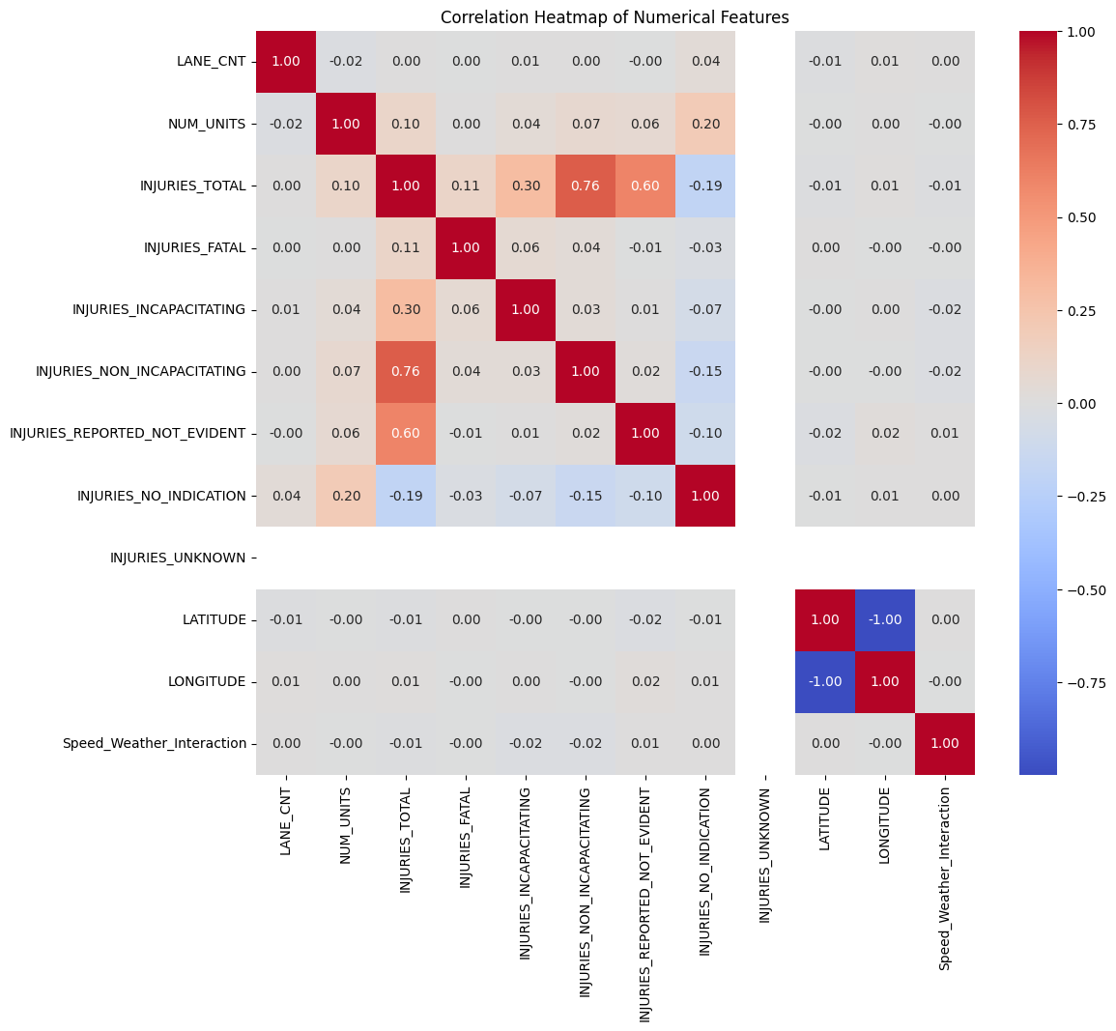
Exploratory Data Analysis (EDA)

Slide 6
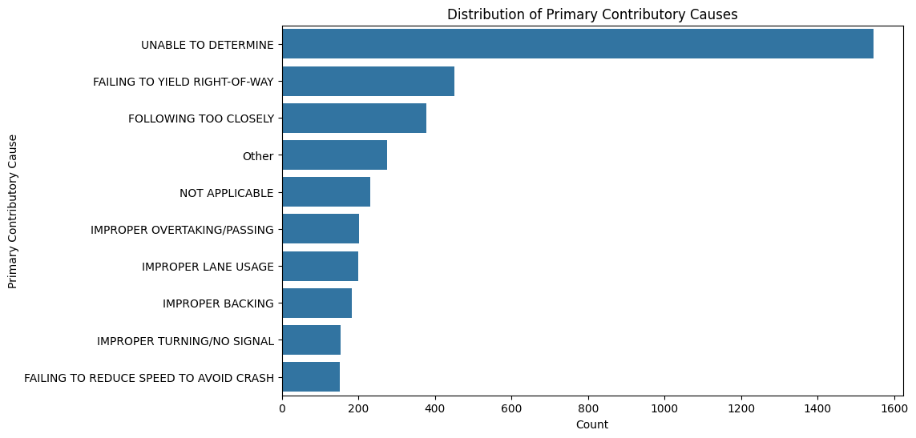

Slide 7
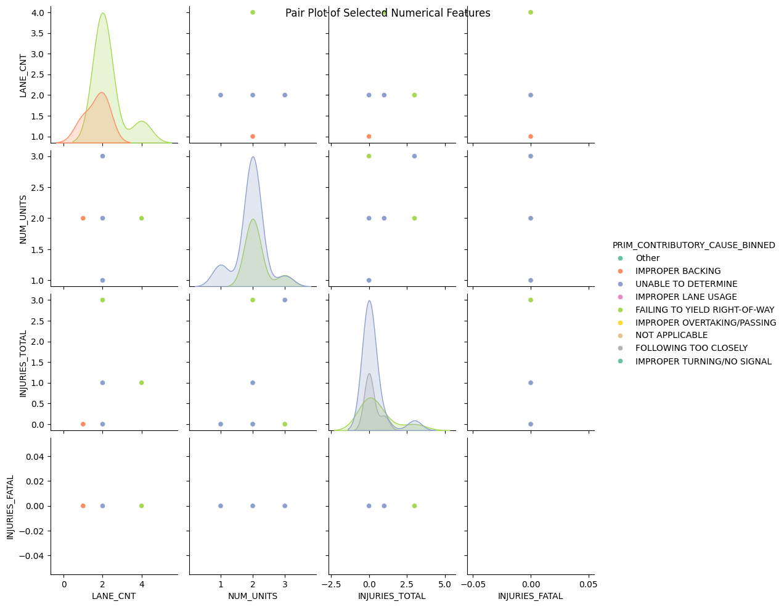

Slide 8
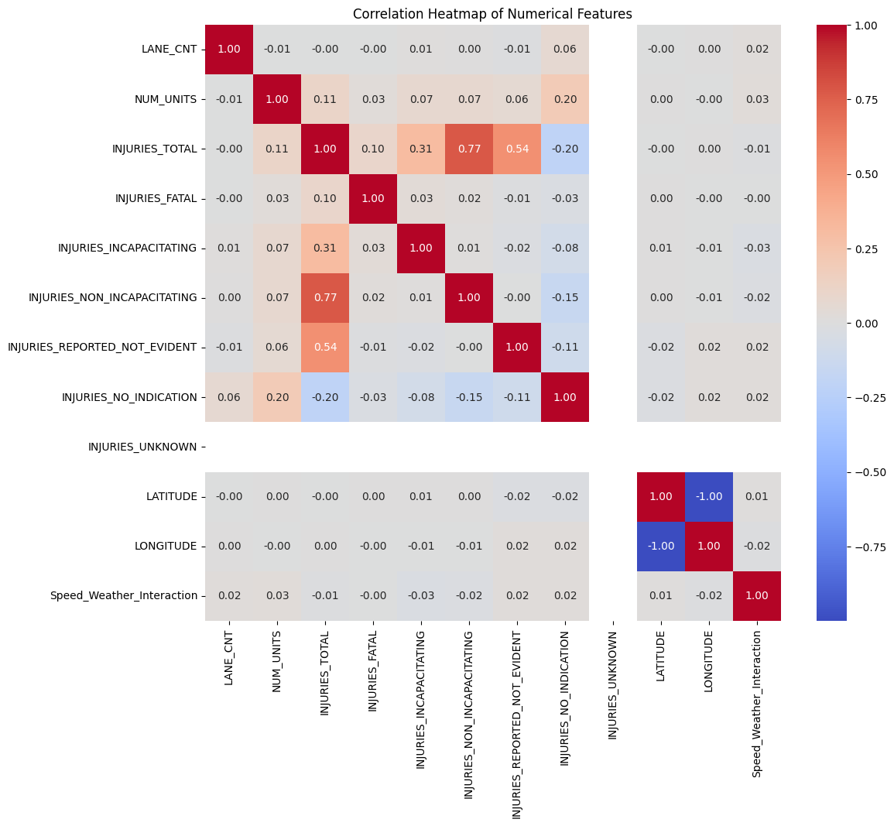
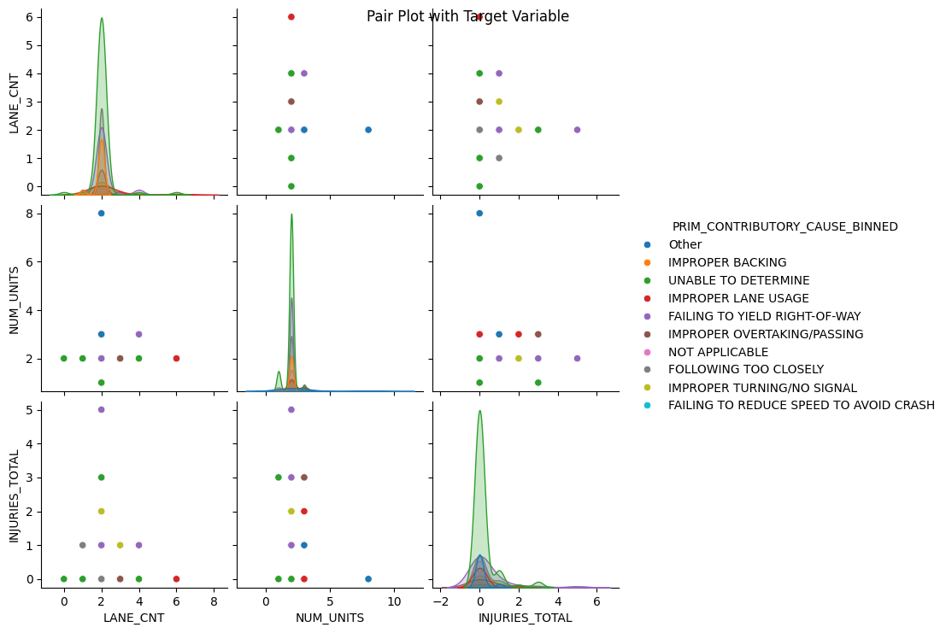
Multivariate analysis

Slide 9
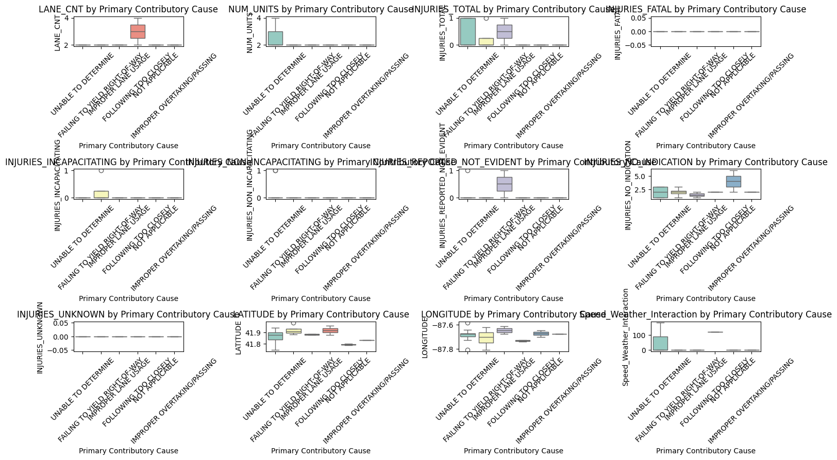

Slide 10
Modeling Approach
Models Tested:
Models tested were: Logistic Regression, Ridge Classifier, Lasso Logistic Regression, Decision Tree, Random Forest, Gradient Boosting.
Evaluation Metrics:
- Accuracy: The proportion of correct predictions made by the model.
- Precision: The ability of the model to correctly identify positive instances.
- Recall: The ability of the model to capture all positive instances.
- F1-Score: The harmonic mean of precision and recall, balancing the two.
- Confusion Matrix: A detailed breakdown of the model's performance across different classes.

Slide 11
Model Comparison
Performance Overview: The bar chart below represents the performance of each model.
Best Model: Gradient Boosting in general became the best for this problem because of how large the dataset is.
It combines the strengths of ensemble learning with the flexibility of Decision Trees, allowing it to model complex non-linear relationships, handle interactions between features and generalize well on unseen data. Its performance were further enhanced through Hyperparameter Tuning, which likely led to it outperforming the other models tested.

Slide 12
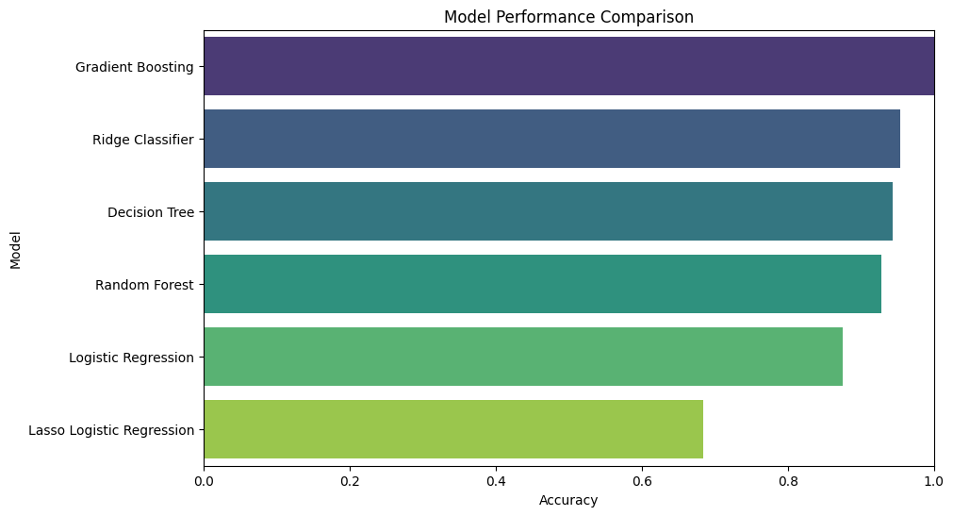
Models performance

Slide 13
Top Features: Below is a bar chart showing the top 10 features by importance.
Interpretation:
High uncertainty: Many accidents have unclear causes ("UNABLE TO DETERMINE").
Right-of-way issues: Failing to yield is a major cause.
Following too closely: Leads to frequent rear-end collisions.
Improper driving: Unsafe behaviors like improper lane usage and overtaking are common.
Driver skills: Lack of experience and knowledge also contribute to accidents.

Slide 14
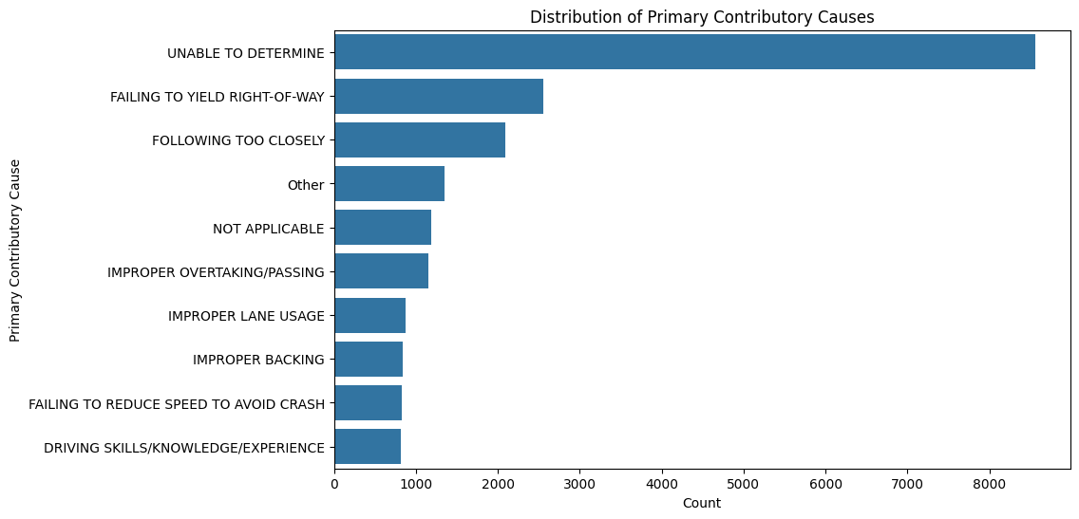
Top Features by Importance

Slide 15
Insights
Summary of Key Insights: Key features that heavily influenced the likelihood of an accident included weather conditions, road surface conditions, lighting conditions, and the type of traffic control devices.
The interaction between speed and weather conditions was particularly notable, indicating that accidents are more likely when adverse weather coincides with higher speeds.
Visuals: Below are visuals that supports our insights.

Slide 16
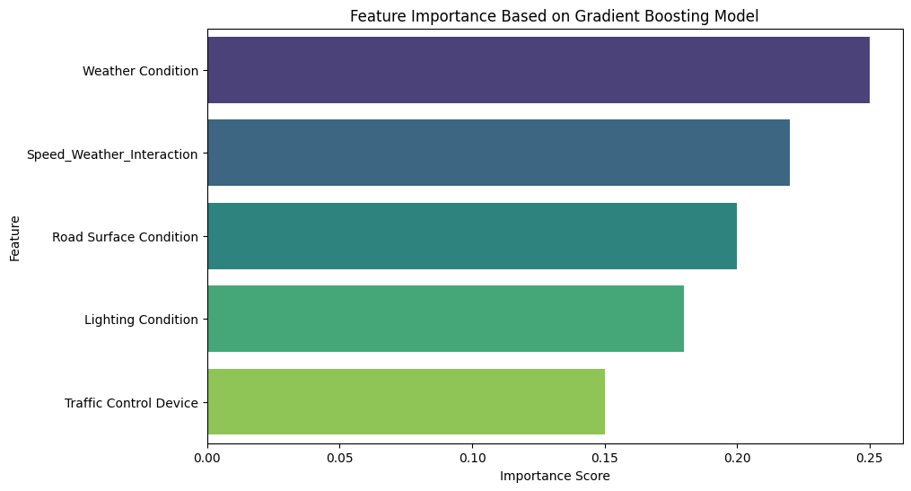
Feature importance bar chart based on gradient boosting outputs model

Slide 17
Recommendations
Targeted Safety Campaigns
Improved Road Infrastructure
Adaptive Speed Limits
Enhanced Law Enforcement
Further Research

Slide 18
Conclusion
Final Thoughts: The analysis of the traffic crash data has provided valuable insights into the primary contributory causes of accidents and the critical factors influencing road safety. By identifying the top features and causes associated with accidents, we can make informed recommendations to enhance road safety in the City of Chicago
By implementing these recommendations, the City of Chicago can reduce traffic accidents, enhance road safety, and ultimately save lives. The insights gained from this analysis provide a clear pathway to making the city's roads safer for everyone.

Slide 19
Next Steps
Consider deploying the best-performing model in a real-time traffic monitoring system to provide proactive alerts and reduce accident rates.

Slide 20
Q&A

